Slide 1
Introduction to Web Application Security
Eng. Deniz Ozdemir, MSc., PhD candidate at Charles University
Ethical hacker
Offensive Security Certified Professional (OSCP)
GIAC Penetration Tester (GPEN)
Researcher at Czech Technical University in Prague

Slide 2

Background information
Studied Bsc and Msc at Linnaeus University, Sweden
Computer science engineering: Network security
Worked as an ethical hacker in Sweden, Turkey and Czech Republic
Both governmental and private entities, banking and insurance sectors
Information security officer
Information Risk management officer
Have collaborated and continuously working with numerous international ethical hackers in various projects in UK, Netherlands and Belgium, covering a wide span of technical and theoretical activities to professionals, students, C-level managers ☺

Slide 3
Background information cont.
Researcher and lecturer at Czech Technical University, Prague
Faculty of Biomedical engineering and assistive technologies
Working on two projects:
Citizen Scientists Investigating Cookies and App GDPR compliance (https://cordis.europa.eu/project/id/873169)
StudyATHome International
PhD candidate at Charles University
Faculty of Humanities
Investigating social robots and transhumanism – the future of mankind (and hacking such systems as well ☺)
Guest lecturer at Coventry University, United Kingdom
Guest lecturer at Technikum Wien, Austria
Actively involved in international conferences, lectures, and events
Sweden Alumni student ambassador representative in Czech Republic
OWASP Sweden Student Chapter Leader

Slide 4

Background information (final!)
Ever-learning drummer, music enthusiast
Part-time artist studied in Finland (concept art, traditional charcoal, ink sketches)
Traveller
Reader
Explorer
Good news for students: Adapting Finnish & Swedish education system
Learning without stress or too long details (hopefully!)
Practical assignment freedom
Flexible approach

Slide 5
What’s on our schedule today? 4hours
IT security terminology
Foundations of security
Fundamentals of data protection
Defense-in-depth
Layered security
Disclaimer and ethical considerations
OSI layers
HTTP protocol
HTTP security
OWASP project
Top 10 vulnerabilities – attacks and mitigation techniques
How to think like a hacker
Switching the mindset from developer to breaker in order to improve your coding with security aspects
Lots of brainstorming
Imagination on doomsday scenarios and how to be protected
Webgoat instructions and various technical hacking demos
Demo – how to start hacking specifically-vulnerable-by-design applications
Precautions
CSI-COP and other IT security initiatives
Project: Security review of your chosen project

Slide 6
What to expect / what not to expect from this course
The most essential security concepts, specifically web application penetration testing is introduced.
You are encouraged to go online and dig deeper for the further concepts. All the terminology may seem overwhelming first, but do not be discouraged, it is put for your own reference.
Some practical demos are provided to see how the work have the live action, very simple beginner hacking exercises are specifically chosen to lay out the foundations of IT security. This is the very first introduction guest lecture to just give you an idea of how hacking works, how attacks are simulated.
You are not expected to learn all concepts by once, it is important to remember at least some concepts after finishing this course ☺

Slide 7
Disclaimer
Hacking is an unauthorized intrusion which is a negative connotation and is never considered an ethical thing to do therefore the term is always questioned. Ethical hacking is also known as penetration testing, intrusion testing, or red teaming but it is not only limited to penetration testing. If hacking is offensive, ethical hacking is defensive.
You are not encouraged to illegally break into the systems with the knowledge that you have gained throughout this course.
ANY ACTIONS AND OR ACTIVITIES RELATED TO THE MATERIAL CONTAINED WITHIN THIS COURSE IS SOLELY YOUR RESPONSIBILITY. THE MISUSE OF THE INFORMATION IN THIS CAN RESULT IN CRIMINAL CHARGES BROUGHT AGAINST THE PERSONS IN QUESTION. THE INSTRUCTOR OR THE PLATFORM WILL NOT BE HELD RESPONSIBLE IN THE EVENT ANY CRIMINAL CHARGES BE BROUGHT AGAINST ANY INDIVIDUALS MISUSING THE INFORMATION IN THIS COURSE TO BREAK THE LAW.

Slide 8

Part I – An introduction to IT security concepts

Slide 9
Terminology
Security is required when the threat is present.
Threat must be known.
The weak entry points must be known that raises a threat (vulnerability).
A threat is any potential occurrence, malicious or otherwise, that could harm an asset.
A vulnerability is a weakness that makes a threat possible.
An example: Weak input validation is an example of an application layer vulnerability, which can result in input attacks!
An attack in an action that exploits a vulnerability or enacts a threat.
An example: Sending malicious input to an application or flooding a network in an attempt to deny service. Ever experienced to enter a website that is down?

Slide 10
To put it all together
A threat is a potential event that can adversely affect an asset, whereas a successful attack exploits vulnerabilities in a system.
Asset: A resource of value such as the data in a database or on the file system, or a system resource
Entry / exit points: Ways to get an asset
Risk: Likelihood that vulnerability could be exploited
Mitigation: Something that addresses a specific vulnerability
Countermeasure: A safeguard that addresses a threat and mitigates risk

Slide 11
Foundations of security
Confidentiality
Integrity
Availability
Authentication
Authorization
Auditing

Slide 12
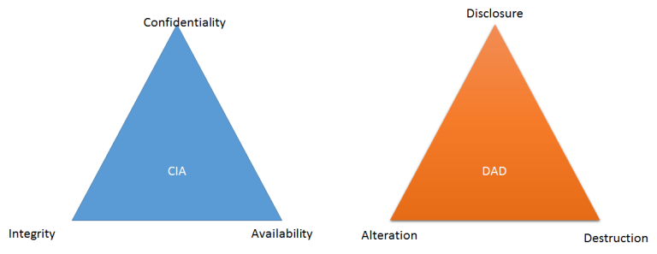
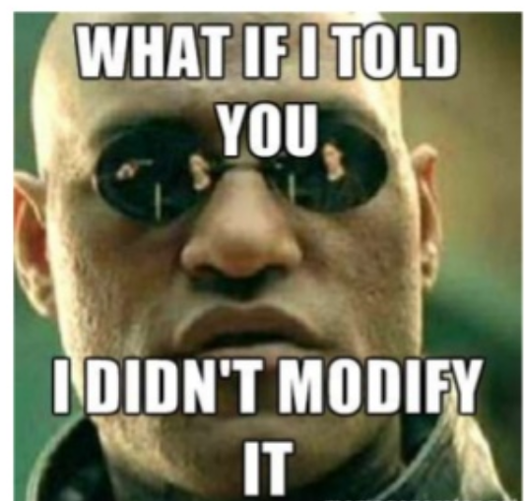
C-I-A Triad

Slide 13
Confidentiality, Integrity, Availability
All issues and solutions pertaining to security fall under 3 categories:
Confidentiality – Protection against unauthorized access
Integrity – Protection against unauthorized modification
Availability – Protection against denial of service
The exact opposite of the CIA is the DAD – Disclosure, Alteration and Destruction.
Locking the door when you leave the house – This is a confidentiality solution because only the person who has the key to unlock the door can enter the house.
A students overwrites the teacher’s Powerpoint presentation – This is an integrity issue because the content of the presentation is already changed.
The system administrator backs up the file server every Friday – This is an availability solution because the backup ensures access to the files when the main file server becomes unavailable.

Slide 14
Confidentiality check
1. How could an intruder harm the security goal of confidentiality? Find the right answer.
Solution 1: By deleting all the databases.
Solution 2: By stealing a database where general configuration information for the system is stored.
Solution 3: By stealing a database where names and emails are stored and uploading it to a website.
Solution 4: Confidentiality can't be harmed by an intruder.

Slide 15
Integrity check
2. How could an intruder harm the security goal of integrity? Find the right answer.
Solution 1: By changing the names and emails of one or more users stored in a database.
Solution 2: By listening to incoming and outgoing network traffic.
Solution 3: By bypassing authentication mechanisms that are in place to manage database access.
Solution 4: Integrity can only be harmed when the intruder has physical access to the database storage.

Slide 16
Availability check
3. How could an intruder harm the security goal of availability? Find the right answer.
Solution 1: By exploiting bugs in the systems software to bypass authentication mechanisms for databases.
Solution 2: By redirecting emails with sensitive data to other individuals.
Solution 3: Availability can only be harmed by unplugging the power supply of the storage devices.
Solution 4: By launching a denial of service attack on the servers.

Slide 17
CIA check
4. What happens if at least one of the CIA security goals is harmed? Find the right answer.
Solution 1: A system can be considered safe until all the goals are harmed. Harming one goal has no effect on the systems security.
Solution 2: The systems security is compromised even if only one goal is harmed.
Solution 3: It's not that bad when an attacker reads or changes data, at least some data is still available, hence only when the goal of availability is harmed the security of the system is compromised.
Solution 4: It shouldn't be a problem if an attacker changes data or makes it unavailable, but reading sensitive data is not tolerable. Theres only a problem when confidentiality is harmed.

Slide 18

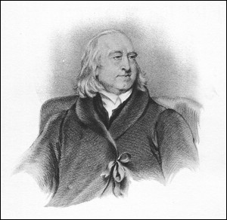
Ethical considerations in security
Kant's Three Principles of Morality
Bentham’s Utilitarianism

Slide 19

Authentication: Who are you?

Slide 20
Web authentication
Authentication is used by a server when the server needs to know exactly who is accessing their information or site.
Authentication is used by a client when the client needs to know that the server is system it claims to be.
In authentication, the user or computer has to prove its identity to the server or client.
Usually, authentication by a server entails the use of a user name and password. Other ways to authenticate can be through cards, retina scans, voice recognition, and fingerprints.
Authentication by a client usually involves the server giving a certificate to the client in which a trusted third party such as Verisign or Thawte states that the server belongs to the entity (such as a bank) that the client expects it to.
Authentication does not determine what tasks the individual can do or what files the individual can see. Authentication merely identifies and verifies who the person or system is.

Slide 21
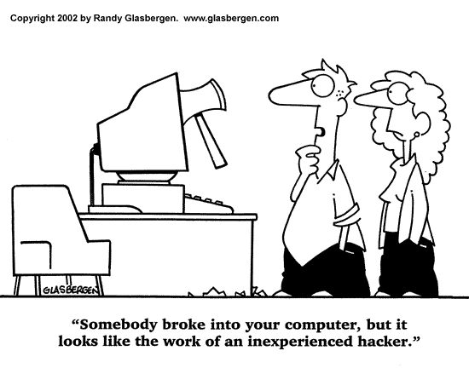
Authorization: What can you do?

Slide 22
Authorization
Authorization is a process by which a server determines if the client has permission to use a resource or access a file.
Authorization is usually coupled with authentication so that the server has some concept of who the client is that is requesting access.
The type of authentication required for authorization may vary; passwords may be required in some cases but not in others.
In some cases, there is no authorization; any user may be use a resource or access a file simply by asking for it. Most of the web pages on the Internet require no authentication or authorization.

Slide 23
Encryption
Encryption involves the process of transforming data so that it is unreadable by anyone who does not have a decryption key.
The Secure Shell (SSH) and Socket Layer (SSL) protocols are usually used in encryption processes. The SSL drives the secure part of “https://” sites used in e-commerce sites (like E-Bay and Amazon.com.)
All data in SSL transactions is encrypted between the client (browser) and the server (web server) before the data is transferred between the two.
All data in SSH sessions is encrypted between the client and the server when communicating at the shell.
By encrypting the data exchanged between the client and server information like social security numbers, credit card numbers, and home addresses can be sent over the Internet with less risk of being intercepted during transit.

Slide 24

Auditing: key to non-repudiation* * Non repudiation guarantees that a user cannot deny performing an operation or initiating a transaction

Slide 25
When to use them?
Authentication, authorization, and encryption are used in every day life. One example in which authorization, authentication, and encryption are all used is booking and taking an airplane flight.
Encryption is used when a person buys their ticket online at one of the many sites that advertises cheap ticket. Upon finding the perfect flight at an ideal price, a person goes to buy the ticket. Encryption is used to protect a person’s credit card and personal information when it is sent over the Internet to the airline. The company encrypts the customer’s data so that it will be safer from interception in transit.
Authentication is used when a traveller shows his or her ticket and driver’s license at the airport so he or she can check his or her bags and receive a boarding pass. Airports need to authenticate that the person is who he or she says she is and has purchased a ticket, before giving him or her a boarding pass.
Authorization is used when a person shows his or her boarding pass to the flight attendant so he or she can board the specific plane he or she is supposed to be flying on. A flight attendant must authorize a person so that person can then see the inside of the plane and use the resources the plane has to fly from one place to the next.

Slide 26
Some examples
Encryption should be used whenever people are giving out personal information to register for something or buy a product. Doing so ensures the person’s privacy during the communication. Encryption is also often used when the data returned by the server to the client should be protected, such as a financial statement or test results.
Authentication should be used whenever you want to know exactly who is using or viewing your site. Weblogin is Boston University’s primary method of authentication. Other commercial websites such as Amazon.com require people to login before buying products so they know exactly who their purchasers are.
Authorization should be used whenever you want to control viewer access of certain pages. For example, Boston University students are not authorized to view certain web pages dedicated to professors and administration. The authorization requirements for a site are typically defined in a website’s .htaccess file.
Authentication and Authorization are often used together. For example, students at Boston University are required to authenticate before accessing the Student Link. The authentication they provide determines what data they are authorized to see. The authorization step prevents students from seeing data of other students.

Slide 27
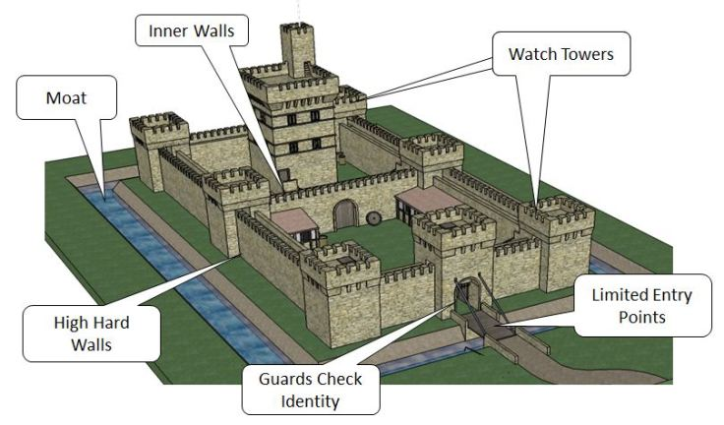
Understanding defense in depth and layered security

Slide 28
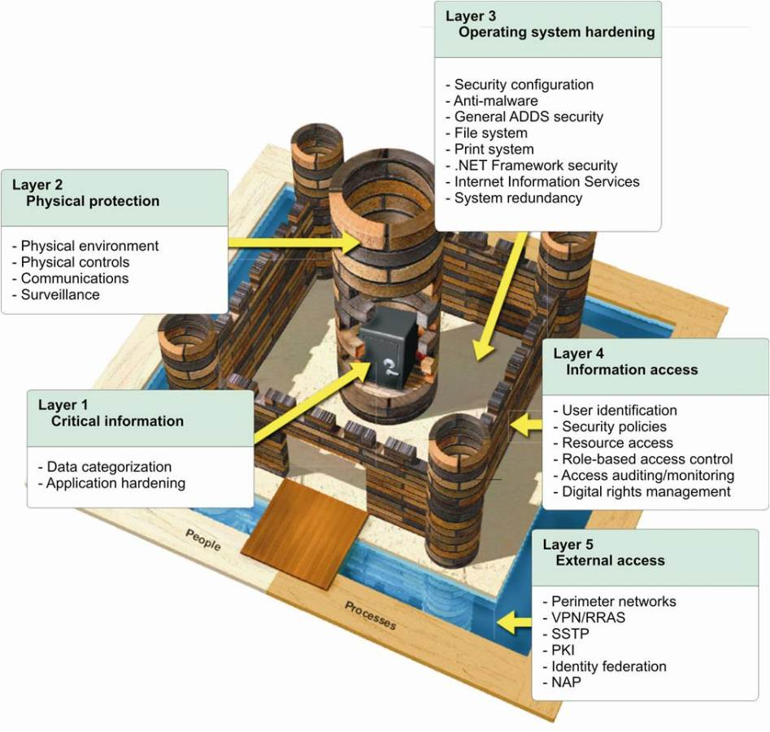

Slide 29
Defense in depth
A defense-in-depth strategy ensures that security controls are present at various layers of the service and that, should any one area fail, there are compensating controls to maintain security at all times.
The strategy also includes tactics to detect, prevent, and mitigate security breaches before they happen.
This involves continuous improvements to service-level security features, including:
Physical controls, video surveillance, access control, smart cards, fire protection etc. - Edge routers, firewalls, intrusion detection, vulnerability scanning - Access control and monitoring, anti-malware, patch and configuration management - Secure engineering (SDL), access control and monitoring, anti-malware - Account management, training and awareness, screening - Threat and vulnerability management, security monitoring, and response, access control and monitoring, file/data integrity, encryption

Slide 30
Defense in depth cont.
Utilizing a proper implementation of defense in depth can increase the time that it takes a hacker to penetrate an organization – which also increases the chances of stopping him or her before he or she is able to steal data or commit other harmful acts.
There is, however, a fundamental flaw in many defense in depth implementations: Often, multiple technologies are added to address the same risks, while other dangers remain effectively ignored. When one considers that one of the primary goals of info-security controls is to protect information, this phenomenon translates into situations in which defense in depth implementations leave information that needs to be protected vulnerable to compromise.
Let’s think for a minute…
Notes:
Consider, for example, internal risks – which are, of course, normally more dangerous than external risks. An employee gone rogue, for example, may know which organizational data is most valuable and where and how it is stored – technology layers that combat only external risks will do nothing to prevent that individual from pilfering information and inflicting serious harm. Layering firewalls, intrusion detection systems, and many other network security tools will not reduce the exposure to the risk posed by an insider – and adding more and more layers that address similar risks will not make the situation any better. Reinforcing the strong parts of a dam does not do much if there is a hole in the structure.

Slide 31
What could go wrong? Let’s discuss!

Slide 32

Defense in depth cont.
Even protecting databases and other data storage repositories will do little to protect against risks that involve people who have access to those stores. Likewise, if you store and process data in the cloud, you are at risk from not only outsiders, but also from the cloud provider itself – and that provider likely has access to your data storage systems. Similar to the case of rogue employee discussed above, if you do not protect your data via encryption et. al. someone working at the cloud provider could potentially access and pilfer your data – layering security technologies will not stop the theft if some of the layers do not address the data risks.
Security is a dynamic process. If there is an open door, surely someone will probe in eventually. Speaking of which, let’s check the current attacks as facts happening around the world as of right now, shall we?

Slide 33
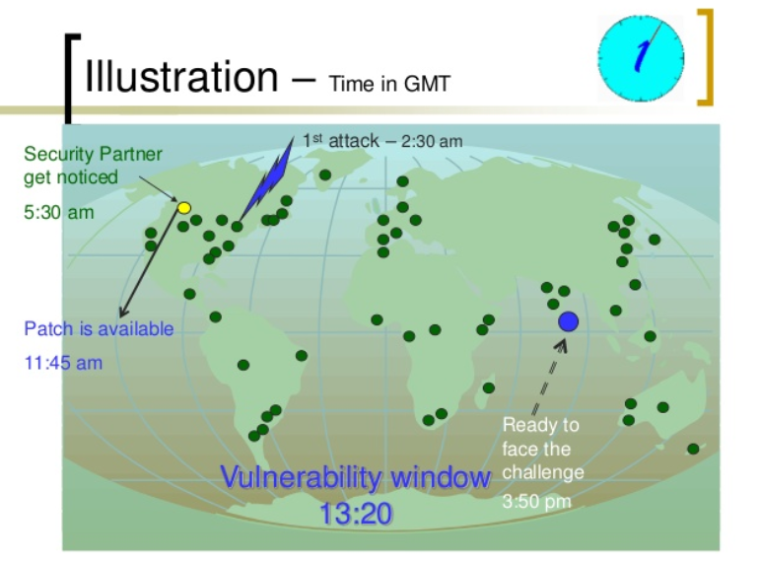

Slide 34
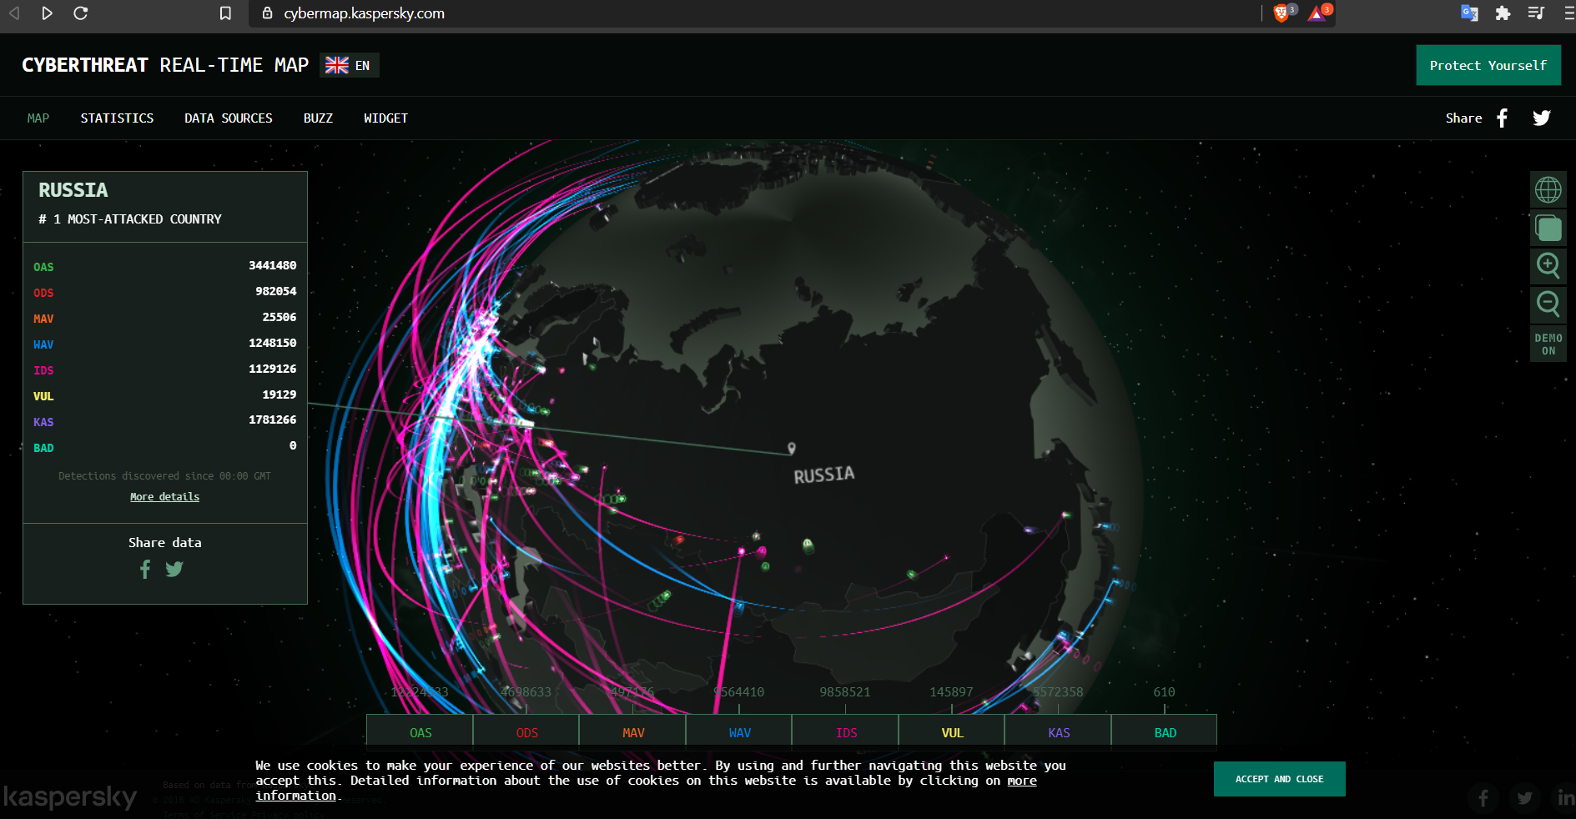
Shall we check the attacks going on at this very minute?

Slide 35
Sensitive data needs to be secured during its entire lifetime wherever it resides.
When you design the “layers” consider how automakers design the safety elements of cars: in the end, all of them serve one goal – to protect humans from injury or death.
The focus of car designers is not on creating better anti-lock brakes for the sake of making braking better, for example, it is to lower the number of collisions and reduce the severity of collisions that do occur.
Each automobile safety feature offers its unique shielding capabilities for the true asset, the people in the vehicle. Information security should follow a similar model – each technology deployed or policy implemented should serve the primary purpose of protecting the data, with some trying to stop breaches and others trying to reduce the severity of danger when a breach occurs.
Keep in mind that because people and systems need to access data in order to function, layering network and application level technologies that simply block access altogether is infeasible and impractical:
Hence, encryption, hashing, tokenization, data masking, and other direct information-protection techniques are often useful when layering. Furthermore, whenever possible, restrict sensitive data to as small as possible a number of systems and networks – and focus security budgets disproportionally on protecting what matters most.

Slide 36
Understanding layered security and defense in depth
A layered approach to security can be implemented at any level of a complete information security strategy. Whether you are the administrator of only a single computer, accessing the Internet from home or a coffee shop, or the go-to guy for a thirty thousand user enterprise WAN, a layered approach to security tools deployment can help improve your security profile.
In short, the idea is an obvious one: that any single defense may be flawed, and the most certain way to find the flaws is to be compromised by an attack -- so a series of different defenses should each be used to cover the gaps in the others' protective capabilities.
Firewalls, intrusion detection systems, malware scanners, integrity auditing procedures, and local storage encryption tools can each serve to protect your information technology resources in ways the others cannot.
Originally coined in a military context, the term "defense in depth" refers to an even more comprehensive security strategy approach than layered security. In fact, on might say that just as a firewall is only one component of a layered security strategy, layered security is only one component of a defense in depth strategy.

Slide 37

OSI Layers
OSI Model Explained - James Bond's mission

Slide 38
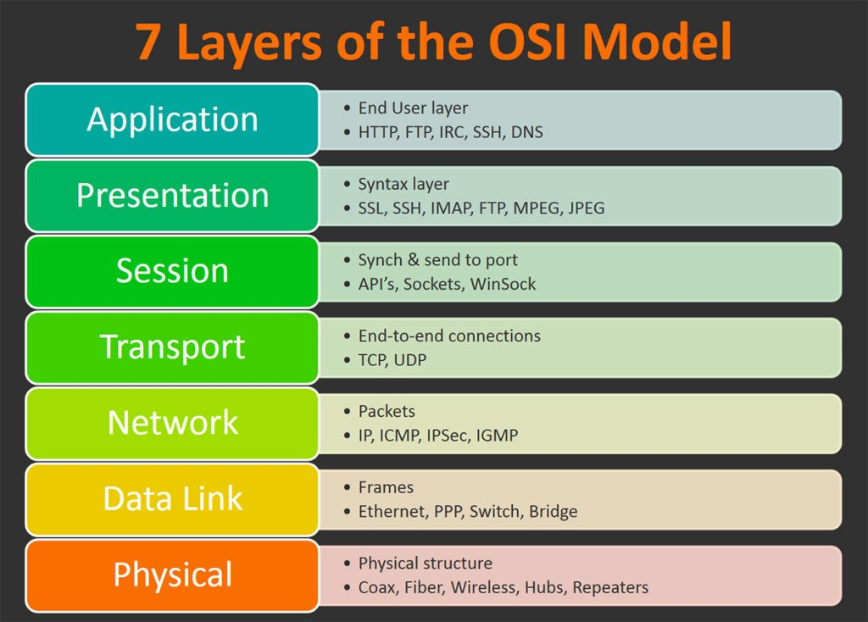
OSI Layers
The Open Systems Interconnection (OSI) model is a conceptual model created by the International Organization for Standardization which enables diverse communication systems to communicate using standard protocols.
OSI provides a standard for different computer systems to be able to communicate with each other.
The OSI model can be seen as a universal language for computer networking. It’s based on the concept of splitting up a communication system into seven abstract layers, each one stacked upon the last.
Please (Physical Layer) Do (Data Link Layer) Not (Network Layer) Tell (Transport Layer) Secret (Session Layer)
Password (Presentation Layer) Anyone (Application Layer )

Slide 39

OSI Layers cont.
It was the first standard model for network communications, adopted by all major computer and telecommunication companies in the early 1980s.
These layers as being defined in terms of numbers, with 1 being the lowest layer in the system, and 7 being the highest layer in the system. Layers 1 to 3 are considered media layers, while layers 4 to 7 are considered host layers.
This model is used to divide the network architecture into seven different layers conceptually.
In every layer, there also involves some security postures and mechanisms that a security professional must know to detect and put the security method effectively.
Please (Physical Layer) Do (Data Link Layer) Not (Network Layer) Tell (Transport Layer) Secret (Session Layer) Password (Presentation Layer) Anyone (Application Layer)

Slide 40
1- The physical layer

Slide 41
2. The Data Link Layer

Slide 42
3. The Network Layer

Slide 43
4. The Transport Layer

Slide 44
5. The Session Layer

Slide 45
6. The Presentation Layer

Slide 46
7. The Application Layer

Slide 47

This is a web development course, what about it?

Slide 48

Break time! 10 minutes ☺

Slide 49
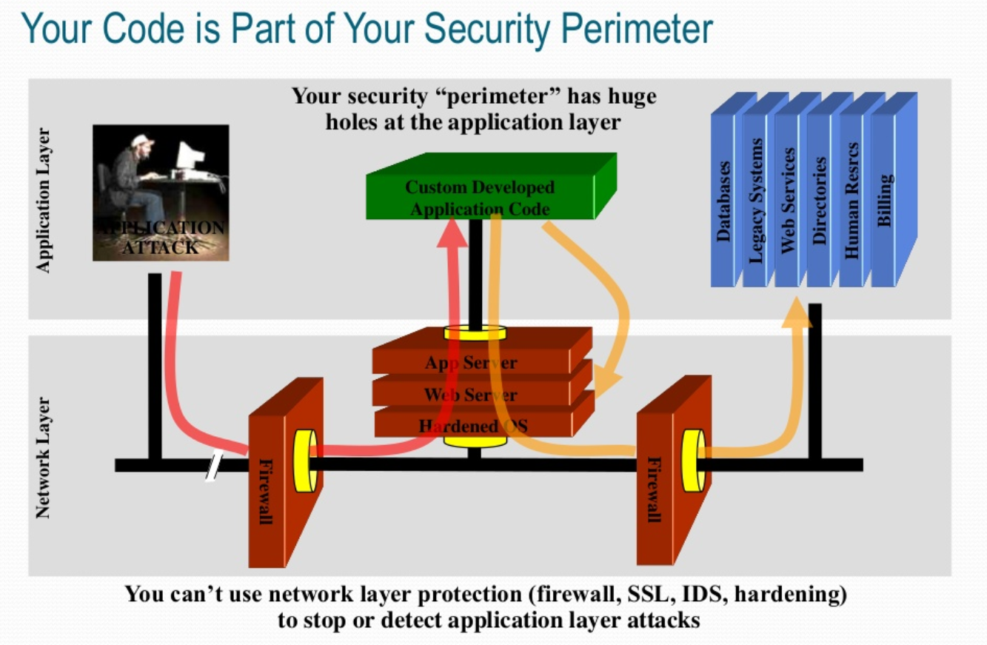

Slide 50
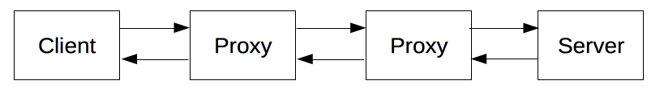
HTTP Protocol
HTTP is a client-server protocol: requests are sent by one entity, the user-agent (or a proxy on behalf of it). Most of the time the user-agent is a Web browser, but it can be anything, for example a robot that crawls the Web to populate and maintain a search engine index.
Each individual request is sent to a server, which handles it and provides an answer, called the response. Between the client and the server there are numerous entities, collectively called proxies, which perform different operations and act as gateways or caches, for example.
In reality, there are more computers between a browser and the server handling the request: there are routers, modems, and more. Thanks to the layered design of the Web, these are hidden in the network and transport layers. HTTP is on top, at the application layer. Although important to diagnose network problems, the underlying layers are mostly irrelevant to the description of HTTP.

Slide 51
The WebServer
On the opposite side of the communication channel, is the server, which serves the document as requested by the client. A server appears as only a single machine virtually: this is because it may actually be a collection of servers, sharing the load (load balancing) or a complex piece of software interrogating other computers (like cache, a DB server, or e-commerce servers), totally or partially generating the document on demand.
A server is not necessarily a single machine, but several server software instances can be hosted on the same machine. With HTTP/1.1 and the Host header, they may even share the same IP address.

Slide 52
Proxies
Between the Web browser and the server, numerous computers and machines relay the HTTP messages. Due to the layered structure of the Web stack, most of these operate at the transport, network or physical levels, becoming transparent at the HTTP layer and potentially making a significant impact on performance.
Those operating at the application layers are generally called proxies. These can be transparent, forwarding on the requests they receive without altering them in any way, or non-transparent, in which case they will change the request in some way before passing it along to the server. Proxies may perform numerous functions:
caching (the cache can be public or private, like the browser cache)
filtering (like an antivirus scan or parental controls)
load balancing (to allow multiple servers to serve the different requests)
authentication (to control access to different resources)
logging (allowing the storage of historical information)

Slide 53
HTTP flow
When a client wants to communicate with a server, either the final server or an intermediate proxy, it performs the following steps:
Open a TCP connection: The TCP connection is used to send a request, or several, and receive an answer. The client may open a new connection, reuse an existing connection, or open several TCP connections to the servers.
Send an HTTP message: HTTP messages (before HTTP/2) are human-readable. With HTTP/2, these simple messages are encapsulated in frames, making them impossible to read directly, but the principle remains the same.

Slide 54
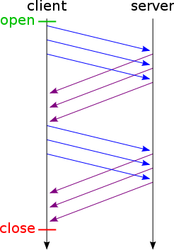
HTTP flow cont.
If HTTP pipelining is activated, several requests can be sent without waiting for the first response to be fully received. HTTP pipelining has proven difficult to implement in existing networks, where old pieces of software coexist with modern versions. HTTP pipelining has been superseded in HTTP/2 with more robust multiplexing requests within a frame.
HTTP pipelining is a feature of HTTP 1.1 persistent connections. It means that you can send multiple requests on the same socket without waiting for each response.
HTTP is based on TCP, and one of TCP's guarantees is ordered delivery. This means that all of the requests sent out on the same socket, will be received in that order on the server. An HTTP server that supports HTTP pipelining will send its responses in the same order.
HTTPS pipelining is also possible with secure HTTP connections and it gives an even greater degree of speed because of the extra needed SSL/TLS handshakes.

Slide 55
HTTP Messages
HTTP messages, as defined in HTTP/1.1 and earlier, are human-readable. In HTTP/2, these messages are embedded into a binary structure, a frame, allowing optimizations like compression of headers and multiplexing. Even if only part of the original HTTP message is sent in this version of HTTP, the semantics of each message is unchanged and the client reconstitutes (virtually) the original HTTP/1.1 request. It is therefore useful to comprehend HTTP/2 messages in the HTTP/1.1 format.
There are two types of HTTP messages, requests and responses, each with its own format.

Slide 56
HTTP Messages – Requests
Requests consists of the following elements:
An HTTP method, usually a verb like GET, POST or a noun like OPTIONS or HEAD that defines the operation the client wants to perform. Typically, a client wants to fetch a resource (using GET) or post the value of an HTML form (using POST), though more operations may be needed in other cases.
The path of the resource to fetch; the URL of the resource stripped from elements that are obvious from the context, for example without the protocol (http://), the domain (developer.mozilla.org), or the TCP port (here, 80).
The version of the HTTP protocol.
Optional headers that convey additional information for the servers.
Or a body, for some methods like POST, similar to those in responses, which contain the resource sent.

Slide 57
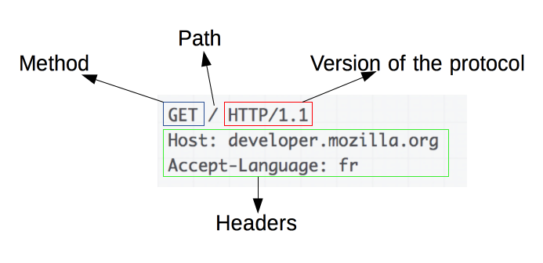
HTTP Messages – Requests cont.
An example HTTP request:

Slide 58
HTTP Messages – Responses
Responses consist of the following elements:
The version of the HTTP protocol they follow.
A status code, indicating if the request was successful, or not, and why.
A status message, a non-authoritative short description of the status code.
HTTP headers, like those for requests.
Optionally, a body containing the fetched resource.

Slide 59
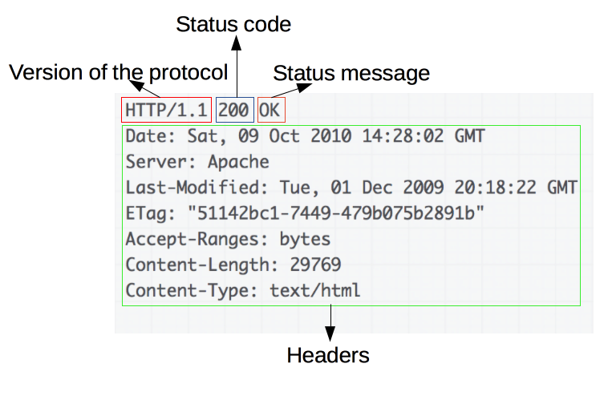
HTTP Messages – Responses cont.
An example response:

Slide 60
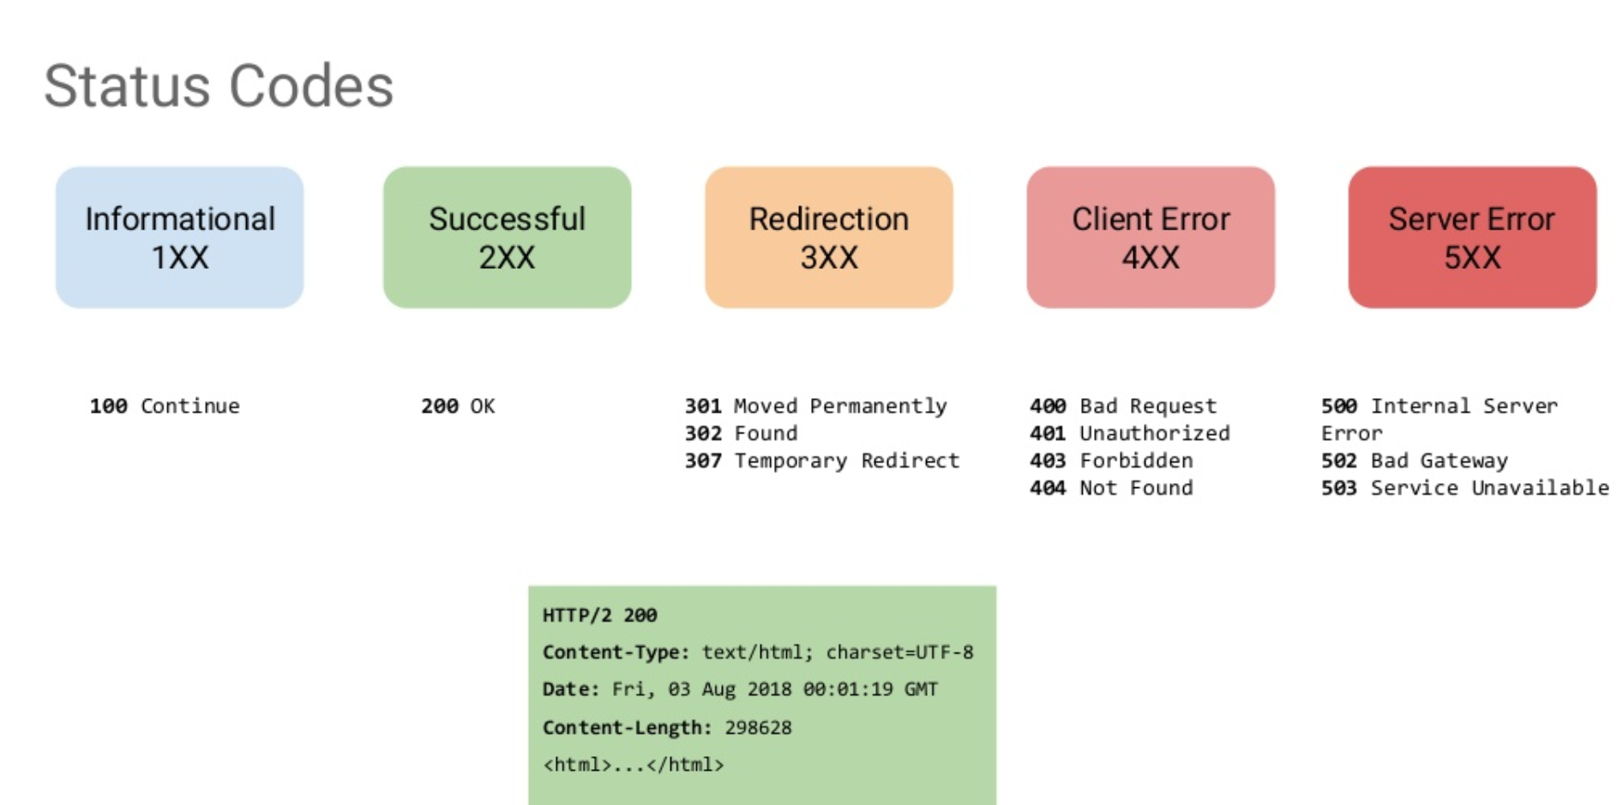

Slide 61
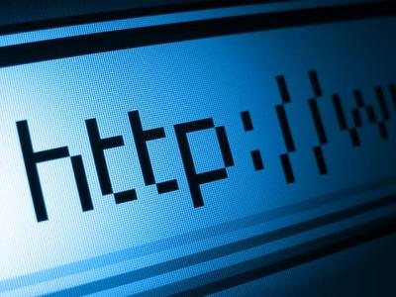
HTTP - Conclusion
HTTP is an extensible protocol that is easy to use. The client-server structure, combined with the ability to simply add headers, allows HTTP to advance along with the extended capabilities of the Web.
Though HTTP/2 adds some complexity, by embedding HTTP messages in frames to improve performance, the basic structure of messages has stayed the same since HTTP/1.0. Session flow remains simple, allowing it to be investigated, and debugged with a simple HTTP message monitor.

Slide 62
HTTP Security
HTTP is used for communications over the internet, so application developers, information providers and users must be aware of the security limitations of it. Here, we can take a look at the possible scenarios what HTTP can reveal from a person’s identity:
HTTP clients are often privy to large amount of personal information such as the user's name, location, mail address, passwords, encryption keys, etc. So you should be very careful to prevent unintentional leakage of this information via the HTTP protocol to other sources.

Slide 63
HTTP Security cont.
All the confidential information should be stored at the server in encrypted form.
Revealing the specific software version of the server might allow the server machine to become more vulnerable to attacks against software that is known to contain security holes.
Proxies that serve as a portal through a network firewall should take special precautions regarding the transfer of header information that identifies the hosts behind the firewall.
The information sent in the 'From' field might conflict with the user's privacy interests or their site's security policy, and hence, it should not be transmitted without the user being able to disable, enable, and modify the contents of the field.
Clients should not include a Referer header field in a (non-secure) HTTP request, if the referring page was transferred with a secure protocol.
Authors of services that use the HTTP protocol should not use GET based forms for the submission of sensitive data, because it will cause the data to be encoded in the Request-URI.

Slide 64
Part II – OWASP Top 10

Slide 65
Shifting mindset to a hacker
In order to get into the mindset of a hacker, you first need to know how you are to think like a hacker. However, as a careful human, always be mindful of your actions and show respect to the boundaries of the exercises.
Pre-engagement Interactions
Intelligence Gathering
Threat Modeling
Vulnerability Analysis
Exploitation
Post Exploitation
Reporting

Slide 66

OWASP Foundation
The Open Web Application Security Project® (shortly as OWASP) is a nonprofit foundation that works to improve the security of software.
The OWASP® Foundation works to improve the security of software through its community-led open source software projects, hundreds of chapters worldwide, tens of thousands of members, and by hosting local and global conferences.
Through community-led open source software projects, hundreds of local chapters worldwide, tens of thousands of members, and leading educational and training conferences, the OWASP Foundation is the source for developers and technologists to secure the web.
Projects
Chapters
Events
Trainings
You can visit for more info: https://owasp.org/

Slide 67
OWASP Projects* https://owasp.org/projects/
All OWASP tools, document, and code library projects are organized into the following categories:
Flagship Projects: The OWASP Flagship designation is given to projects that have demonstrated strategic value to OWASP and application security as a whole. Lab Projects: OWASP Labs projects represent projects that have produced an OWASP reviewed deliverable of value. Incubator Projects: OWASP Incubator projects represent the experimental playground where projects are still being fleshed out, ideas are still being proven, and development is still underway.

Slide 68
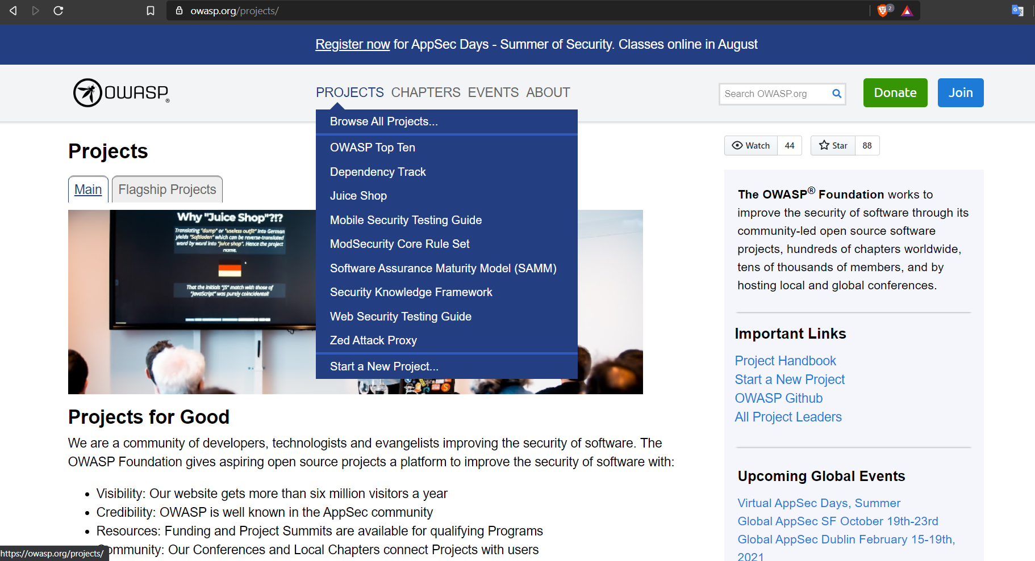

Slide 69

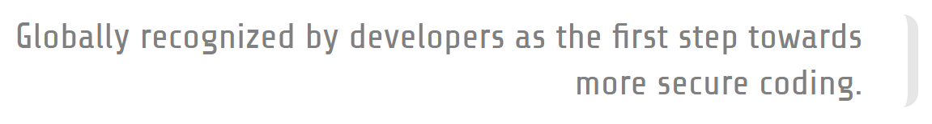
OWASP Top 10
The OWASP Top 10 is a standard awareness document for developers and web application security. It represents a broad consensus about the most critical security risks to web applications.
Companies should adopt this document and start the process of ensuring that their web applications minimize these risks. Using the OWASP Top 10 is perhaps the most effective first step towards changing the software development culture within your organization into one that produces more secure code.

Slide 70
OWASP Top 10 vulnerabilities
Injection
Broken Authentication
Sensitive Data Exposure
XML External Entities (XXE)
Broken Access control
Security misconfigurations
Cross Site Scripting (XSS)
Insecure Deserialization
Using Components with known vulnerabilities
Insufficient logging and monitoring

Slide 71
Practical web application hacking
An ethical hacker (“white hat hacker”) is an information security professional who has the same skills and uses the same technologies as a malicious hacker (“black hat hacker”) to discover vulnerabilities and weaknesses in an organization’s systems.
A black hat hacker operates without the consent of victims, with the goal of financial gain, causing damage, or gaining fame. A white hat hacker or ethical hacker is invited by organizations to help them hack themselves, so to speak, identify security gaps before black hat hackers do, and remediate them.
The first attempts to hack into computer systems were made in the 1960s. In the 1970s, governments and companies set up “tiger teams” whose task was to discover vulnerabilities in telecom and computing systems – the first ethical hackers.
In the 1980s and 1990s, as personal computers became widespread, hacking became a global phenomenon. Gradually the distinction emerged between “black hat” and “white hat” hackers. In 1995 IBM’s John Patrick coined the term “ethical hacking”, and in the years that followed, ethical hacking emerged as a legitimate profession.

Slide 72
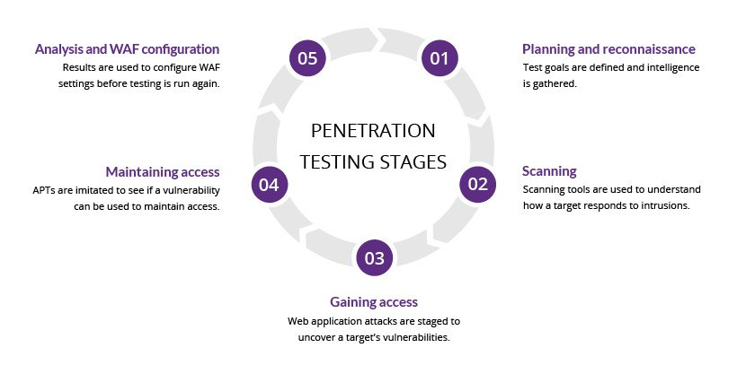
Web application penetration testing

Slide 73

WebGoat* Hacking https://owasp.org/www-project-webgoat/
WebGoat is a deliberately insecure application that allows interested developers just like you to test vulnerabilities commonly found in Java-based applications that use common and popular open source components.
Web application security is difficult to learn and practice. Not many people have full blown web applications like online book stores or online banks that can be used to scan for vulnerabilities. In addition, security professionals frequently need to test tools against a platform known to be vulnerable to ensure that they perform as advertised. All of this needs to happen in a safe and legal environment.

Slide 74
WebGoat* Hacking https://owasp.org/www-project-webgoat/
Even if your intentions are good, we believe you should never attempt to find vulnerabilities without permission. The primary goal of the WebGoat project is simple: create a de-facto interactive teaching environment for web application security. In the future, the project team hopes to extend WebGoat into becoming a security benchmarking platform and a Java-based Web site Honeypot.
WARNING 1: While running this program your machine will be extremely vulnerable to attack. You should disconnect from the Internet while using this program. WebGoat’s default configuration binds to localhost to minimize the exposure.
WARNING 2: This program is for educational purposes only. If you attempt these techniques without authorization, you are very likely to get caught. If you are caught engaging in unauthorized hacking, most companies will fire you. Claiming that you were doing security research will not work as that is the first thing that all hackers claim.

Slide 75
Getting started* https://owasp.org/www-project-webgoat/
1. Standalone
Download the latest WebGoat release from https://github.com/WebGoat/WebGoat/releases
java -jar webgoat-server-8.0.0.VERSION.jar [--server.port=8080] [--server.address=localhost]
The latest version of WebGoat needs Java 11. By default WebGoat starts on port 8080 with --server.port you can specify a different port. With server.address you can bind it to a different address (default localhost)
For further instructions, OWASP Webgoat official website provides always up-to-date information with each release.

Slide 76

Introduction to WebGoat

Slide 77
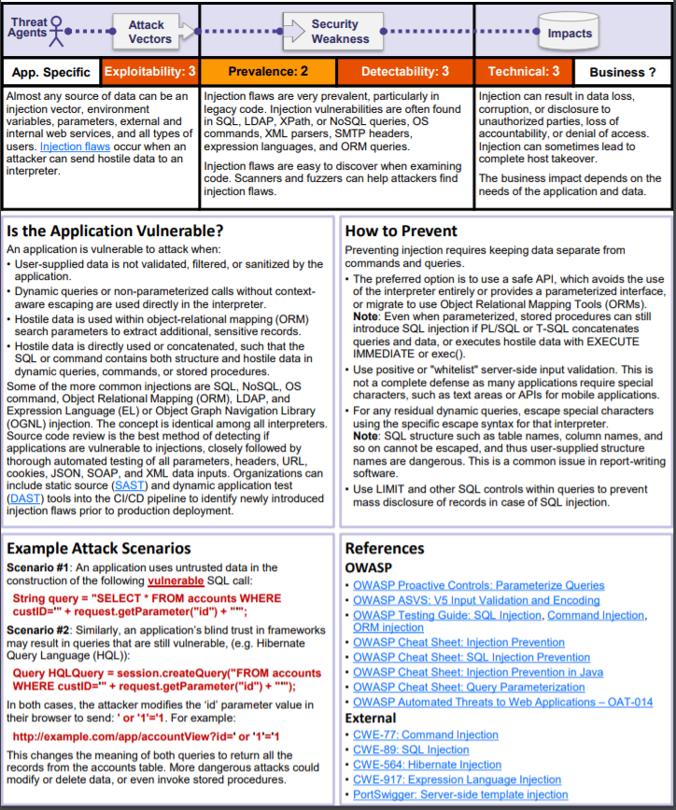
1) Injection

Slide 78
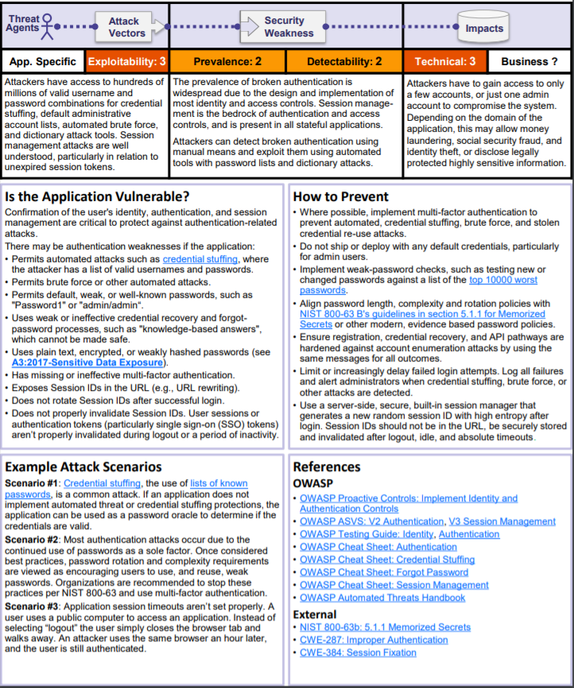
2) Broken Authentication

Slide 79
Demo time: WebGoat hacking Broken authentication and injection (Directory traversal)

Slide 80
How Does It Work: Path Traversal Attacks against a Web Server
The most basic Path Traversal attack uses the "../" special-character sequence to alter the resource location requested in the URL. For example, the following URL will access the file on Unix/Linux systems that store user accounts:
http://example/../../../../../etc/passwd
Since most popular web servers will prevent this technique, alternate encodings of the "../" sequence can be used to bypass the security filters. These method variations include:
With URL-encoding of the forward slash character
http://example/..%2f..%2f..%2fboot.ini

Slide 81
Encoding is the process of converting data from one form to another.
With URL encoding of the backslash character
http://example/..%5c..%5csomeother/file
With Unicode U+FF0E (Fullwidth Full Stop):
https://example:443/%uff0e%uff0e/%uff0e%uff0e/%uff0e%uff0e/%uff0e%uff0e/%uff0e%uff0e/ %uff0e%uff0e/%uff0e%uff0e/%uff0e%uff0e/%uff0e%uff0e/%uff0e%uff0e/%uff0e%uff0e/ %uff0e%uff0e/etc/passwd
With a combination of above:
https://example:443/%uff0e%uff0e/%uff0e%uff0e/%uff0e%uff0e/%uff0e%uff0e/%uff0e%uff0e/%uff0e%uff0e%2fetc%2fpa%uff0e%uff0e/%uff0e%uff0e/%uff0e%uff0e/%uff0e%uff0e/%uff0e%uff0e/%uff0e%uff0e/
sswd

Slide 82
Encoding example – URL encoding
When dealing with URLs, they can only contain printable ASCII characters (these are characters with ASCII codes between decimal 32 and 126, i.e. hex 0x20 – 0x7E).
However, some characters within this range may have special meanings within the URL or within the HTTP protocol. URL encoding comes into play when we have either some characters with special meaning in the URL or want to have characters outside the printable range.
To URL encode a character we simply prefix its hex value with a % e.g.:
Note that as part of the URL encoding scheme you can also represent a space using +. This is often confused with Unicode encoding due to the fact that both begin with %, however Unicode encoding is a little bit more involved.
% - %25
space - %20
tab - %09
= - %3D

Slide 83
How Does It Work: Path Traversal Attacks against a Web Application
One variation of the attack is to substitute a URL parameter with the file name of one of the web application's dynamic scripts:
Original: http://example.com/foo.cgi?home=index.htm
Attack: http://example.com/foo.cgi?home=foo.cgi
Original: http://example.com/scripts/foo.cgi?page=menu.txt
Attack: http://example/scripts/foo.cgi?page=../scripts/foo.cgi%00txt
As a result of the above substitution, the source code of the web application is interpreted as text and the source code will be sent back to the browser.
In the above examples, additional special characters such as the dot (".") is used to reveal the listing of the current working directory, and the "%00" NULL character is used to bypass rudimentary file extension checks.

Slide 84
Break time! 10 minutes ☺

Slide 85
Demo time: WebGoat hacking Cookie impersonation (Authentication spoofing)

Slide 86
Demo time: WebGoat hacking Cookie impersonation further explained (Category: Authorization)
To resolve the exercise, intercept the request in order to locate the cookie named "AuthCookie". By identifying yourself with the "webgoat" ("webgoat" password) and "aspect" ("aspect" password) accounts, you can find the following information:
The common part being 65432, it is likely to be the same for "alice", the user under which you want to identify yourself by creating a cookie.
Moreover, it is clear that "ubphcfx" is written backwards "xfchpbu", and that by transposing each letter with the previous one in the alphabet, we obtain "webgoat". It is the same for "aspect".
Alice is written backwards "ecila", and by transposing the letters by replacing the letter immediately above, we obtain: "fdjmb", or "65432fdjmb" for the complete string.
Username | AuthCookie
webgoat | 65432ubphcfx
aspect | 65432udfqtb

Slide 87
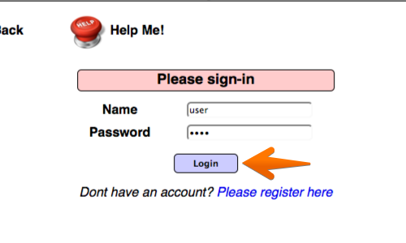
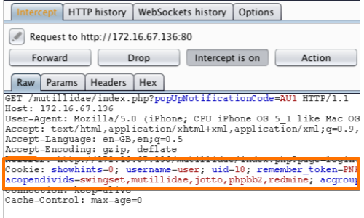
Another scenario: Hacking cookies and manipulating sessions

Slide 88
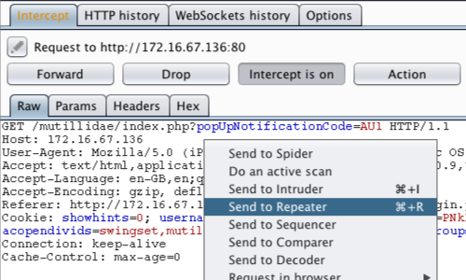
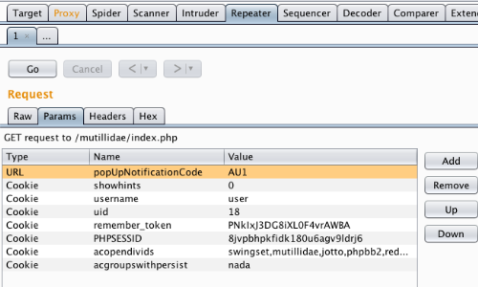
Another scenario: Hacking cookies and manipulating sessions

Slide 89
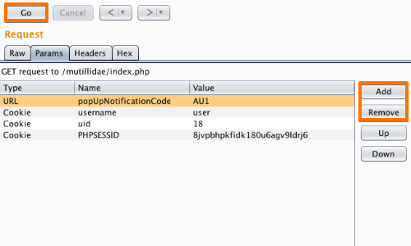
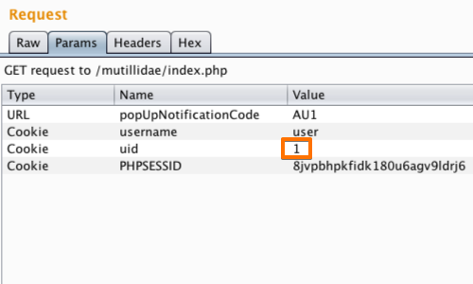
Another scenario: Hacking cookies and manipulating sessions

Slide 90
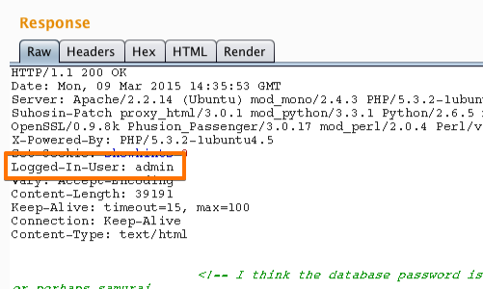
Another scenario: Hacking cookies and manipulating sessions
The response shows that by altering the "uid" cookie we have logged in to the application as "admin".
We have used cookies to manipulate the session and access another account with elevated privileges.

Slide 91
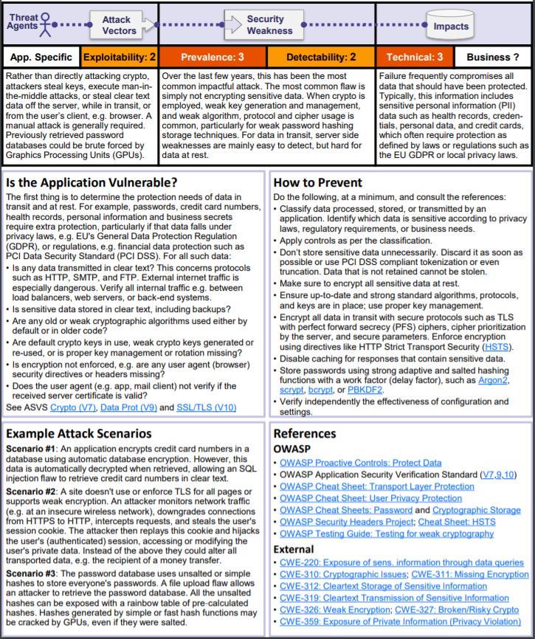
3) Sensitive Data Exposure

Slide 92
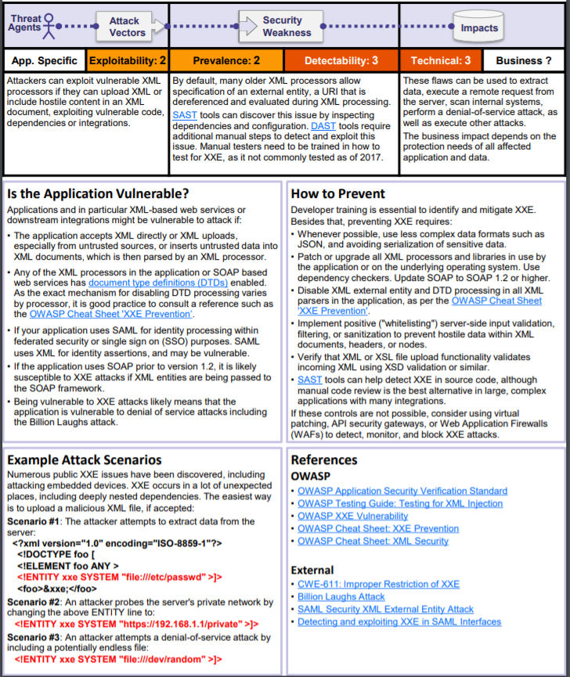
4) XML External Entities (XXE)

Slide 93
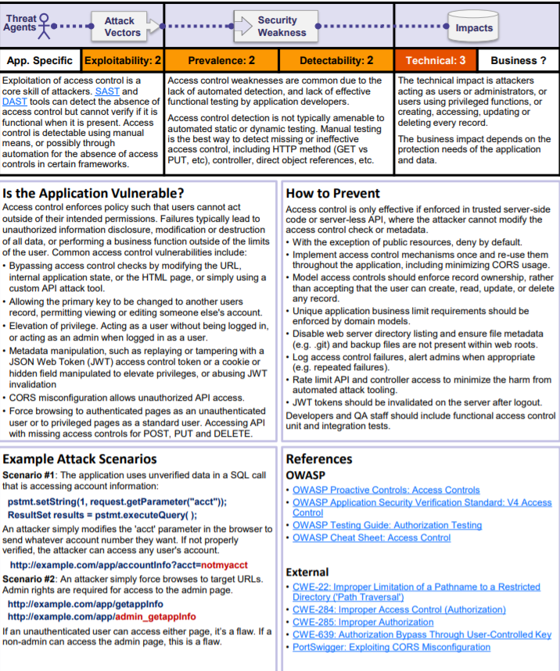
5) Broken access control

Slide 94
Demo time: WebGoat hacking Broken access control (Bypassing security controls)

Slide 95
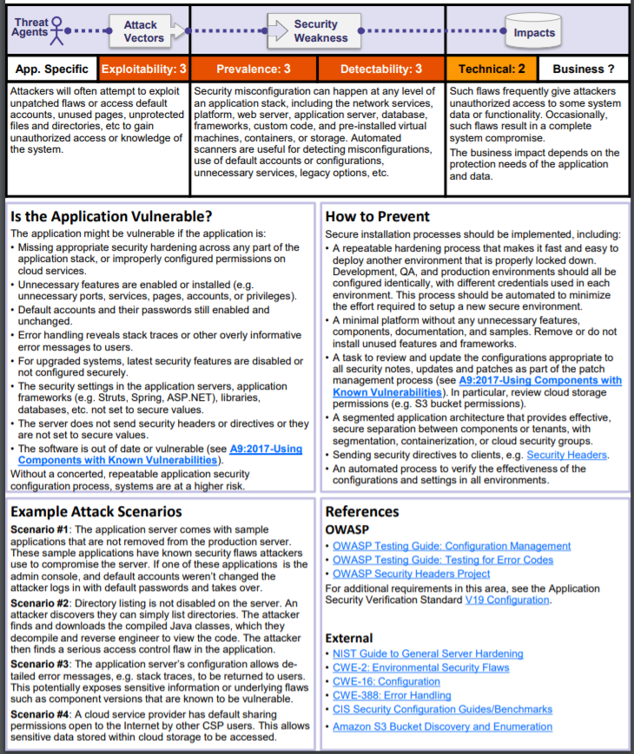
6) Security misconfigurations

Slide 96
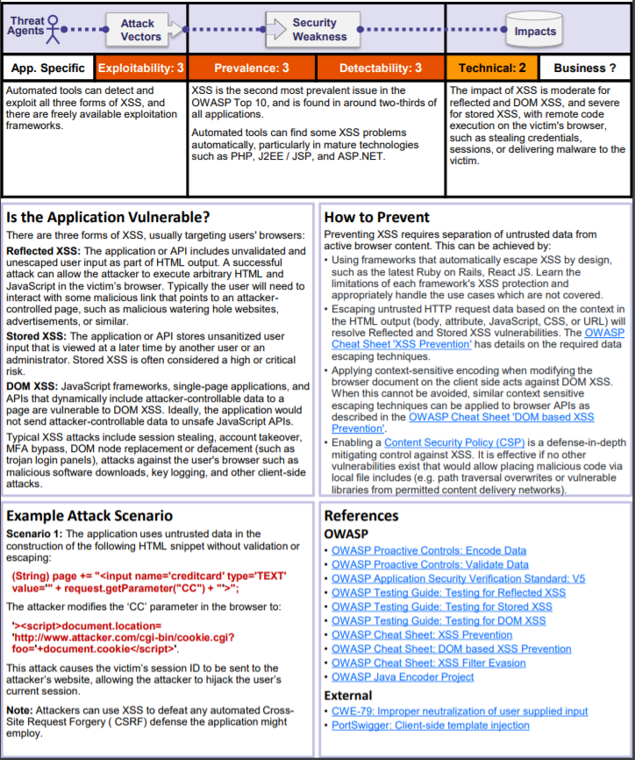
7) Cross Site Scripting (XSS)

Slide 98
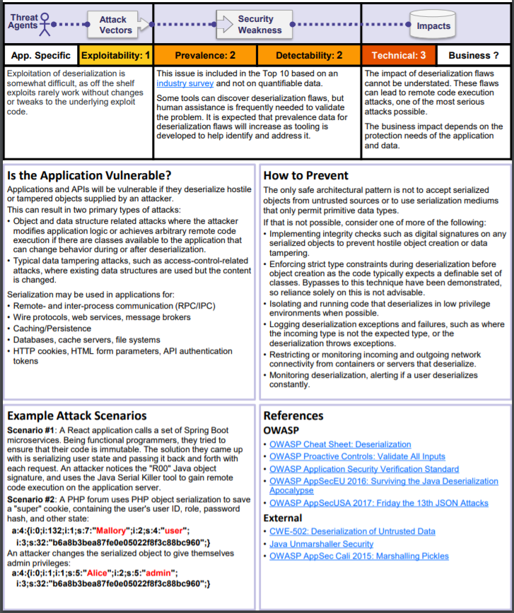
8) Insecure Deserialization

Slide 99
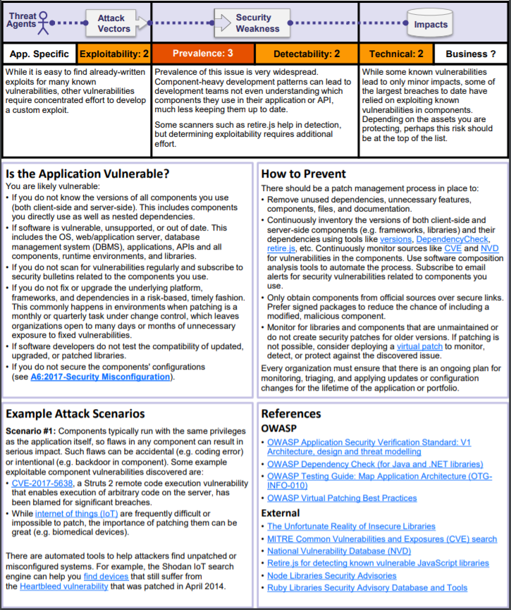
9) Using Components with known vulnerabilities

Slide 100
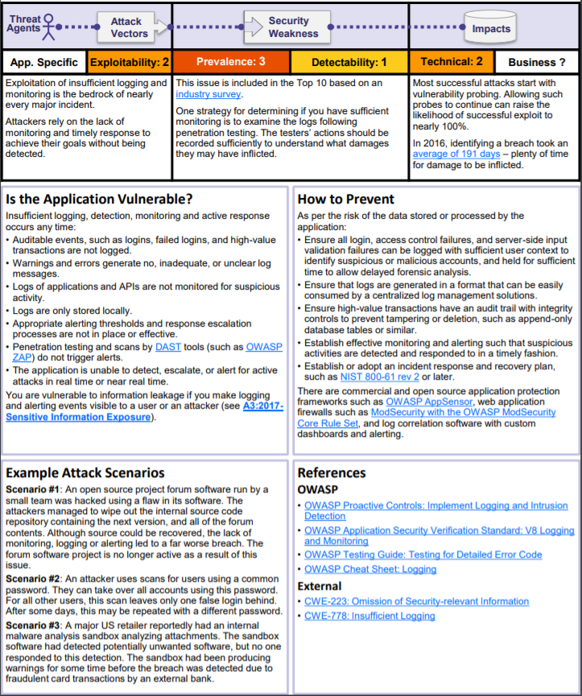
10) Insufficient logging and monitoring

Slide 101
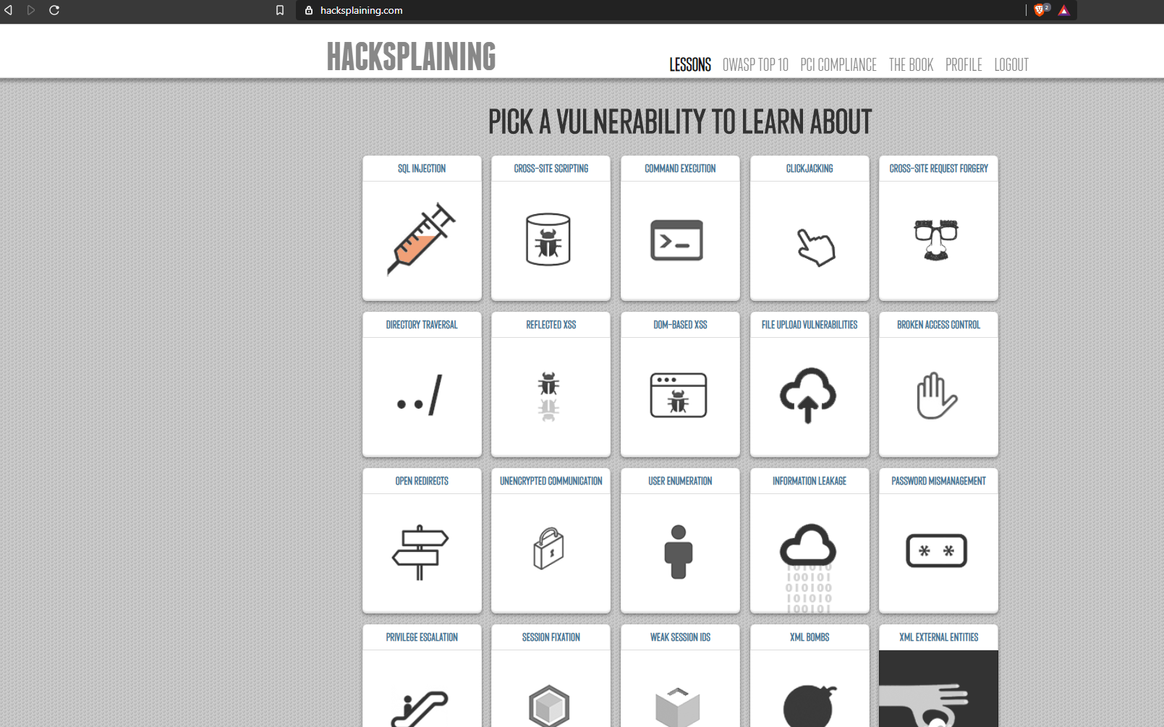
Hacksplaining – Pick a vulnerability to learn about

Slide 102


Slide 103
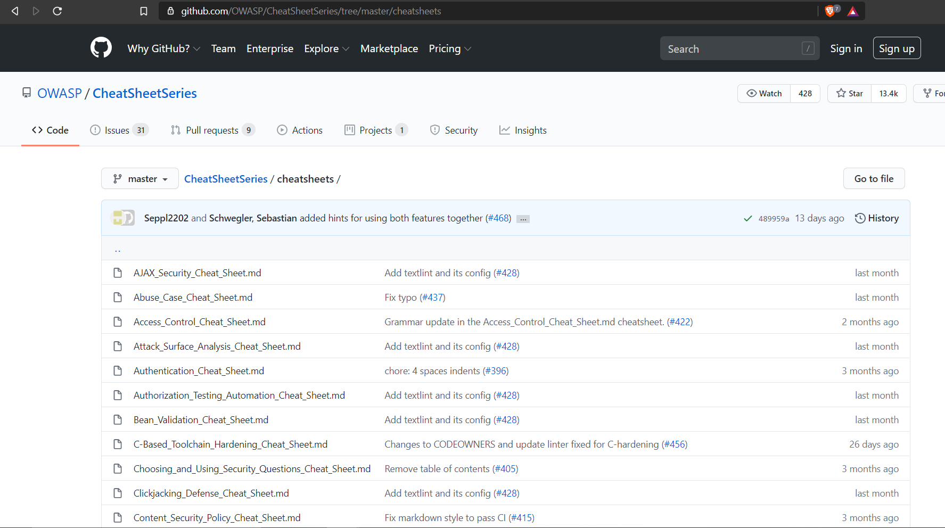

Slide 104

Further topics For interested students!
Experiment further with more vulnerable apps / systems: https://www.amanhardikar.com/mindmaps/Practice.html
OWASP Student Chapter Leader – Sweden
OWASP Czech Republic
Why not collaborate with other OWASP communities?
Engage with your local OWASP Chapter ☺
Gather for the talks and network!
Volunteer for the projects
Subscribe to e-mail lists to be informed
Feel free to reach out to us

Slide 105
CSI-COP: Horizon2020 EU funded project* https://cordis.europa.eu/project/id/873169
Citizen Scientists Investigating Cookies and App GDPR compliance:
The General Data Protection Regulation (GDPR) is an EU law that requires organisations to safeguard personal data and uphold the privacy rights of anyone in EU territory. Citizen scientists can play a valuable role in ensuring privacy and providing a better understanding of what information is tracked online. The EU-funded CSI-COP project will mobilise citizen scientists from across Europe and beyond to investigate the different types of trackers in cookies and apps. Moreover, it will develop methods to preserve privacy in the collection of data. The project will offer training material to informally instruct citizen scientists on the GDPR, aiming to produce a taxonomy of trackers that will subsequently be used to create an open-access repository.

Slide 106
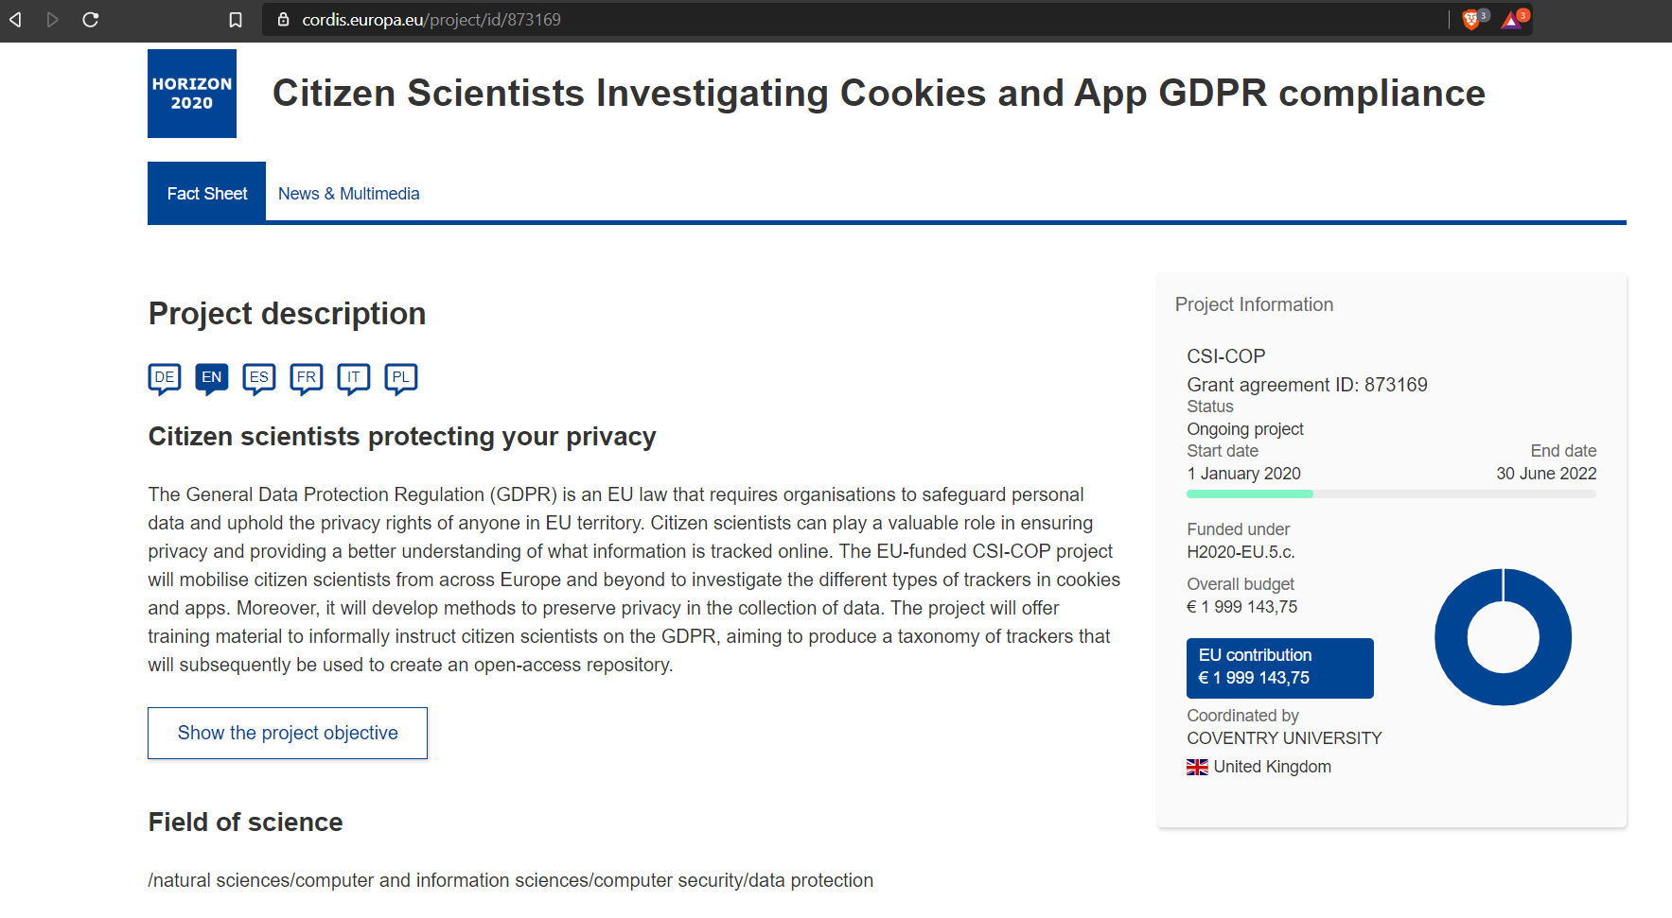
Did you find cookie security interesting and want to learn more and be a part of a research? Web cookies: We are recruiting volunteers ☺

Slide 107
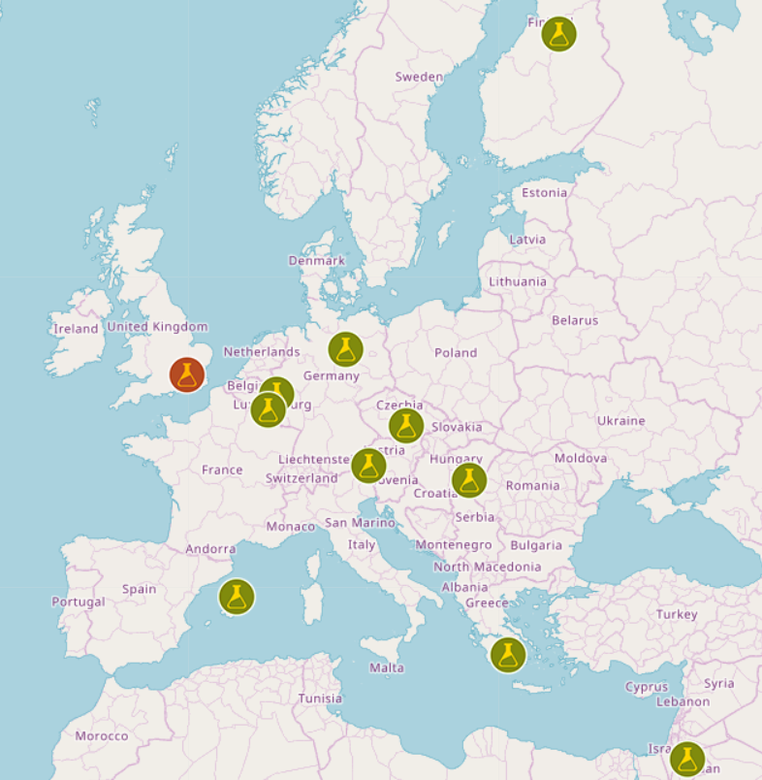
CSI-COP: Horizon2020 EU funded project* https://cordis.europa.eu/project/id/873169
Coventry University, UK

Slide 108
Discussions ‘how your projects can be hacked (misused to be exact)’
First, we will meet one-on-one 30 minutes presentation of your project proposal each, virtually ☺
You will describe your idea of your project orally, no formal presentation is required, the choice is up to you. You will brainstorm on how to implement your work.
Instructor will write down your ideas and provide you with some directions and guidance, if necessary.
Second, we will discuss together again one-on-one on the typical security issues:
Video call to discuss the comments (30 minutes per student)
Paper to outline the attack vectors that shall be applicable for your project
You will put yourself in a hat of a hacker: If I were a hacker, I would use this entry point for my attack.
No stress, this is not a complete and comprehensive security course, instructor aims you to be ‘aware’ of a concept called web application penetration testing and ethical hacking, and allow you to think of the weak entry points for your web application implementation.
In case the students are interested in a complete web application ethical hacking course, then the concepts will be thoroughly explained and instructively detailed demos will be provided respectively ☺

Slide 109
Feel free to go through the pentesting guidelines
http://www.pentest-standard.org/index.php/PTES_Technical_Guidelines
https://www.tutorialspoint.com/security_testing/hacking_web_applications.htm
PTES − Penetration Testing Execution Standard
OSSTMM − Open Source Security Testing Methodology Manual
OWASP Testing Techniques − Open Web Application Security Protocol
https://owasp.org/www-project-application-security-verification-standard/
You can additionally use OWASP Cheat Sheets as well!

Slide 110


Thank you for your attention!

